Slide 1
Smartdeliveryroute: Smart Delivery & Logistics System
Team Members:
• Tejas Thakor (Backend Lead)
• Ayush Kale (AI)
• Harshvarthini (Frontend)
• Subhashini Kandasamy (Frontend Lead)
• Mehek Fatima Sheikh (Frontend)
Date: 9 January 2026

Slide 2
Project Overview
Objective: To build a logistics platform that solves the 'visibility gap’
in last-mile delivery.
What is TrackMile? A web-based system connecting Fleet Managers and Drivers in real-time.
Core Value: Replaces manual phone calls with Live GPS Tracking and Automated Dispatching.
Key Innovation: Integrates Generative AI (Llama 3) to analyze driver performance automatically.

Slide 3
Problem Statement
The logistics industry faces critical challenges:
Lack of Visibility: Admins have zero real-time knowledge of driver locations.
Manual Errors: Assigning orders via phone leads to double-booking.
No Performance Data: Hard to identify efficient drivers without data.
Communication Gap: Drivers struggle to update statuses safely while driving.

Slide 4
Proposed Solution
TrackMile provides a centralized 2-module solution:
1. Centralized Dashboard: A Single Page Application (SPA) for Admins to manage the fleet.
2. Driver Mobile Console: A dedicated interface for accepting jobs and navigation.
3. Real-Time Sync: Instant updates via high-speed polling.
4. Smart Analytics: Automated revenue calculation and AI-driven reviews.

Slide 5
Technical Stack
We used a robust, modern tech stack:
• Frontend: React.js (Dynamic UI, Leaflet Maps)
• Backend: Java Spring Boot (REST API, Security)
• Database: MongoDB (NoSQL for flexible geolocation data)
• AI Engine: Groq API (Llama 3 Large Language Model)
• Tools: Postman (Testing), Maven (Build), Git (Version Control)

Slide 6
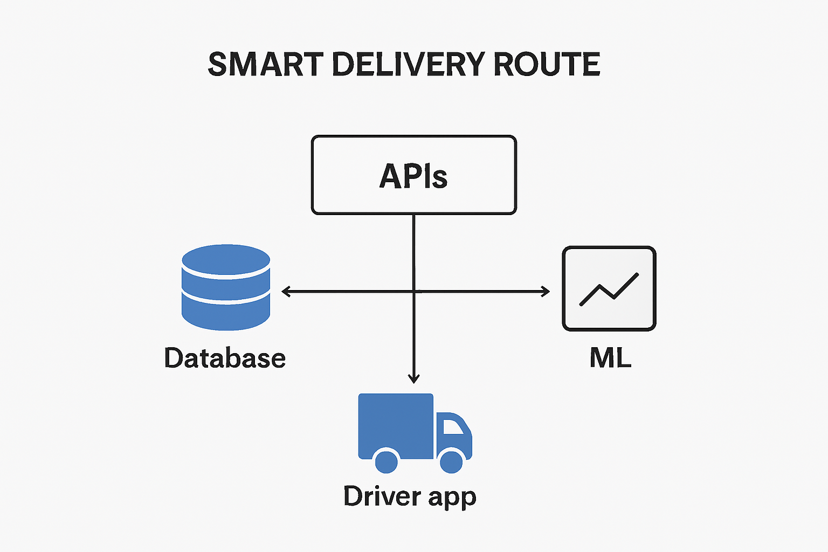
System Architecture
The data flow follows a Client-Server model:
1. React Client sends HTTP requests.
2. Spring Boot API processes logic & security.
3. MongoDB stores JSON data.
4. Groq AI processes history for reports.

Slide 7
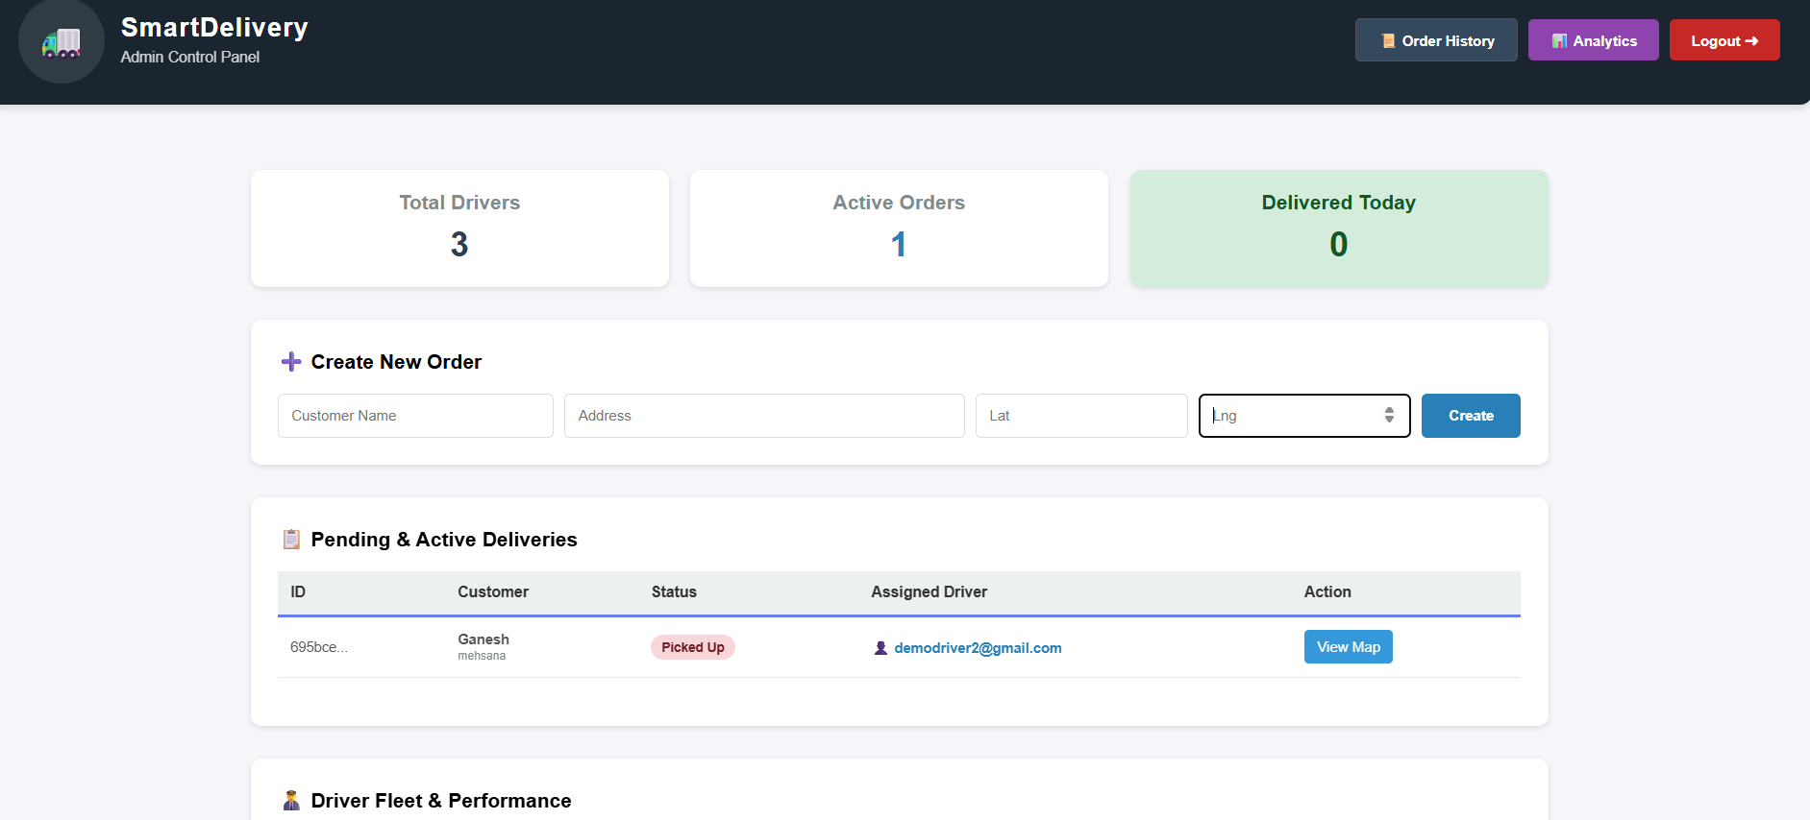
Admin Dashboard
The Command Center for Fleet Managers:
• Live Fleet Stats: View Total Drivers, Active Orders,
Revenue.
• Order Management: Create orders and assign drivers
instantly.
• Map View: Click 'View Map' to track any driver in
real-time.

Slide 8
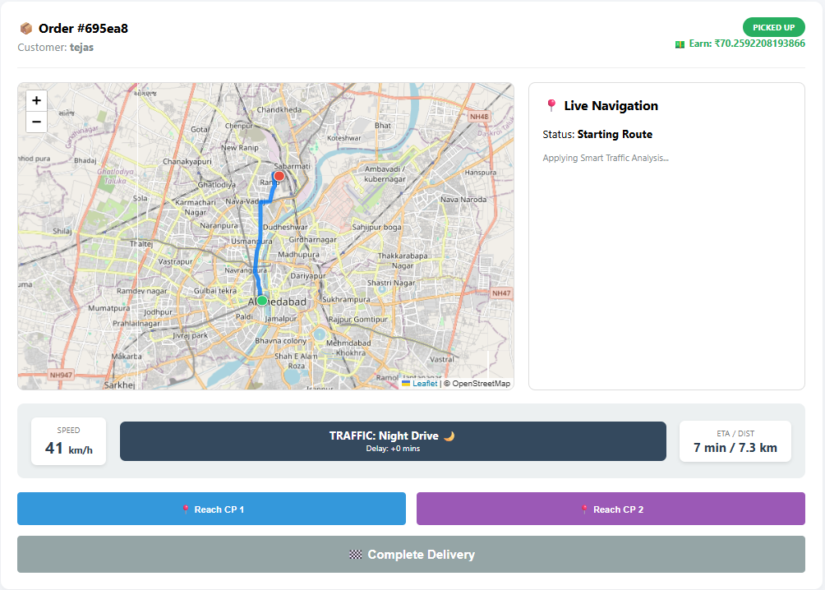
Driver Console
A Mobile-First Interface for Drivers:
Job List: Drivers see only their assigned orders.
Status Control: Buttons to 'Accept', 'Pick Up’,
and 'Deliver'.
Simulated Navigation: 'Reach Checkpoint’
buttons to simulate GPS movement.

Slide 9
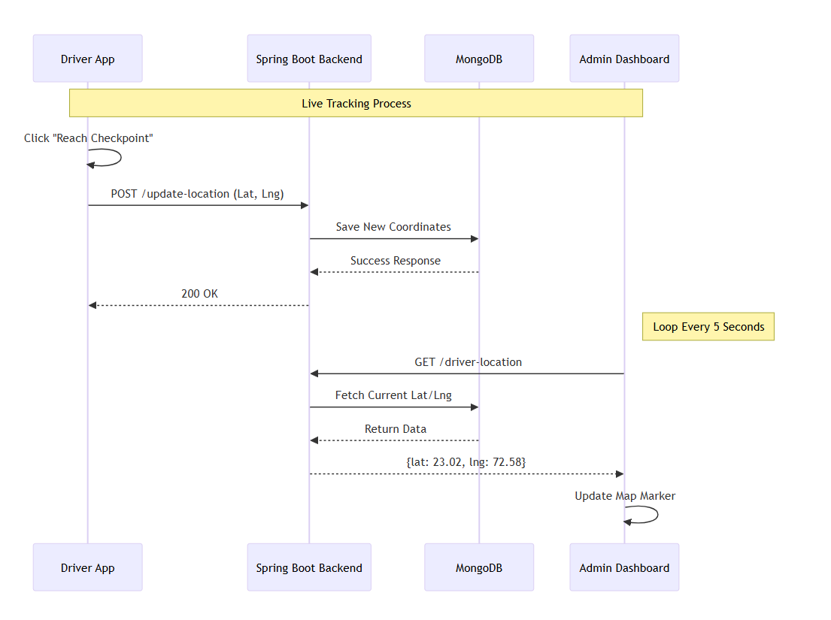
Core Feature: Live Tracking Engine
How we achieved Real-Time Visibility:
1. Driver Action: App sends GPS coords via
POST /update-location.
2. Database: MongoDB updates the driver
document instantly.
3. Admin View: Dashboard polls server
every 5 seconds via GET /driver-location.

Slide 10
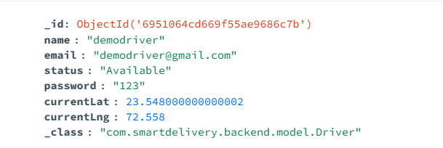
Database Design (MongoDB)
Optimized for high-speed write operations:
drivers: Stores dynamic fields like currentLat,
currentLng, status.
orders: Manages the delivery state machine
(Assigned -> Delivered).
users: Handles role-based authentication.

Slide 11
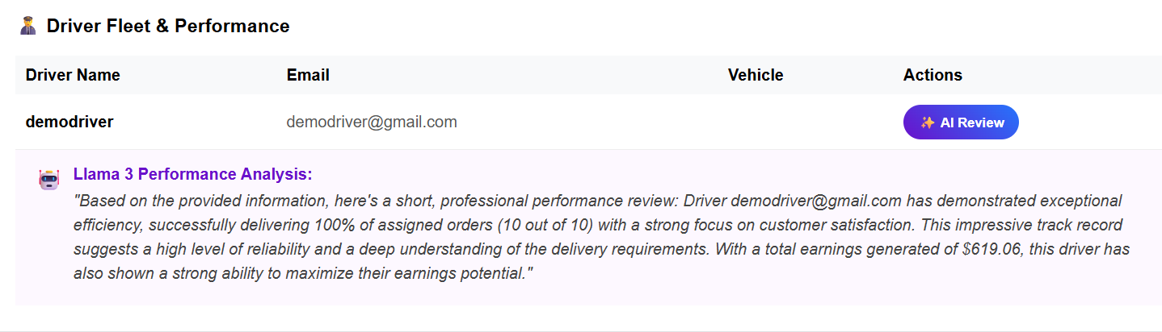
AI Integration (Smart Reporting)
Replacing manual reviews with Llama 3:
1. Backend fetches driver's delivery history.
2. Sends data to Groq API with prompt: 'Analyze reliability...'
3. AI returns a natural language summary displayed on dashboard.

Slide 12
Challenges & Solutions
• Latency Issues: Map updates were slow.
-> Solution: Optimized polling to 5-second intervals.
• Data Accuracy: 'Delivered Today' count was wrong.
-> Solution: Implemented LocalDate filtering in backend.
• Map Crashes: Leaflet component froze on updates.
-> Solution: Implemented 'Safe Re-render' strategy in React.

Slide 13
Future Scope
To scale this project further, we plan to:
• WebSockets: Upgrade from Polling to WebSockets for sub-second updates.
• Mobile App: Convert React frontend to React Native for real GPS access.
• Route Optimization: Algorithms to auto-sort multiple stops for fastest delivery.

Slide 14
Conclusion
TrackMile successfully bridges the gap between manual logistics and automation.
Impact Delivered:
• 100% Visibility of active fleet.
• Reduced Dispatch Time via automated assignment.
• Data-Driven Decisions using AI insights.
Thank You! Questions?

